Slide 1
Raise a Million Dollars

Slide 2
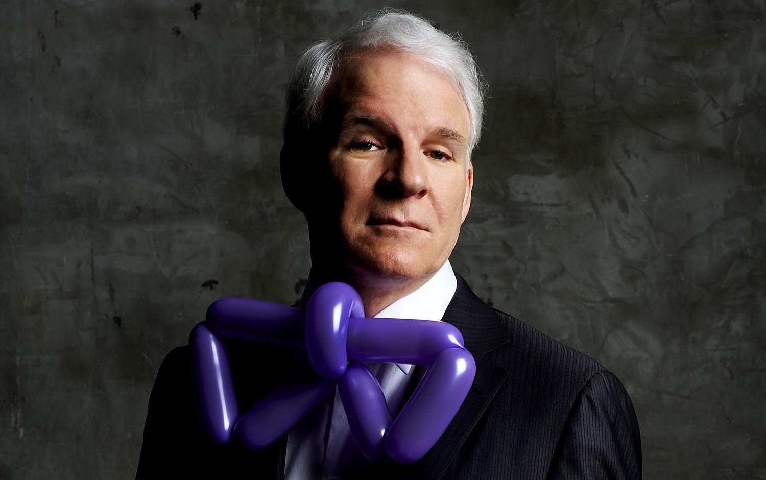

Slide 3
#1

Slide 4
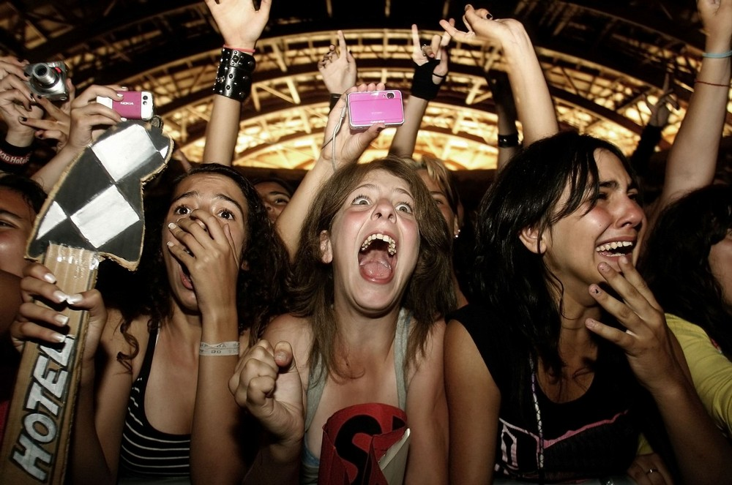

Slide 5
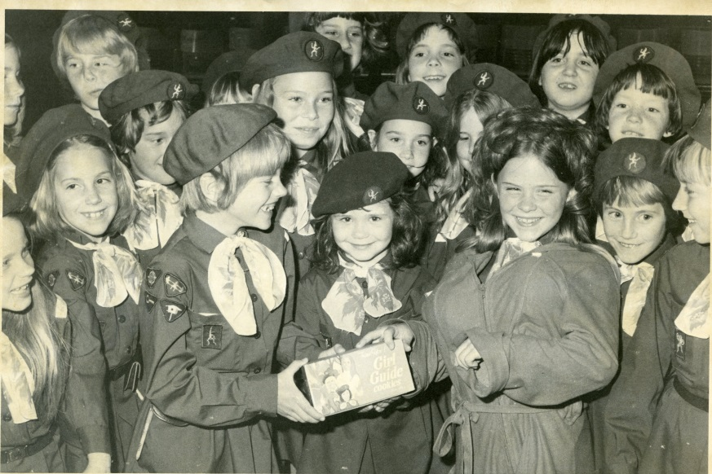

Slide 7
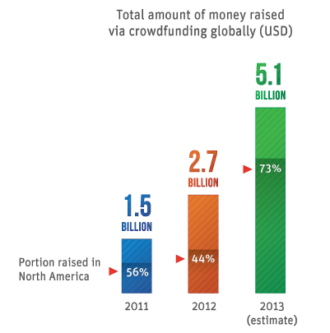

Slide 8
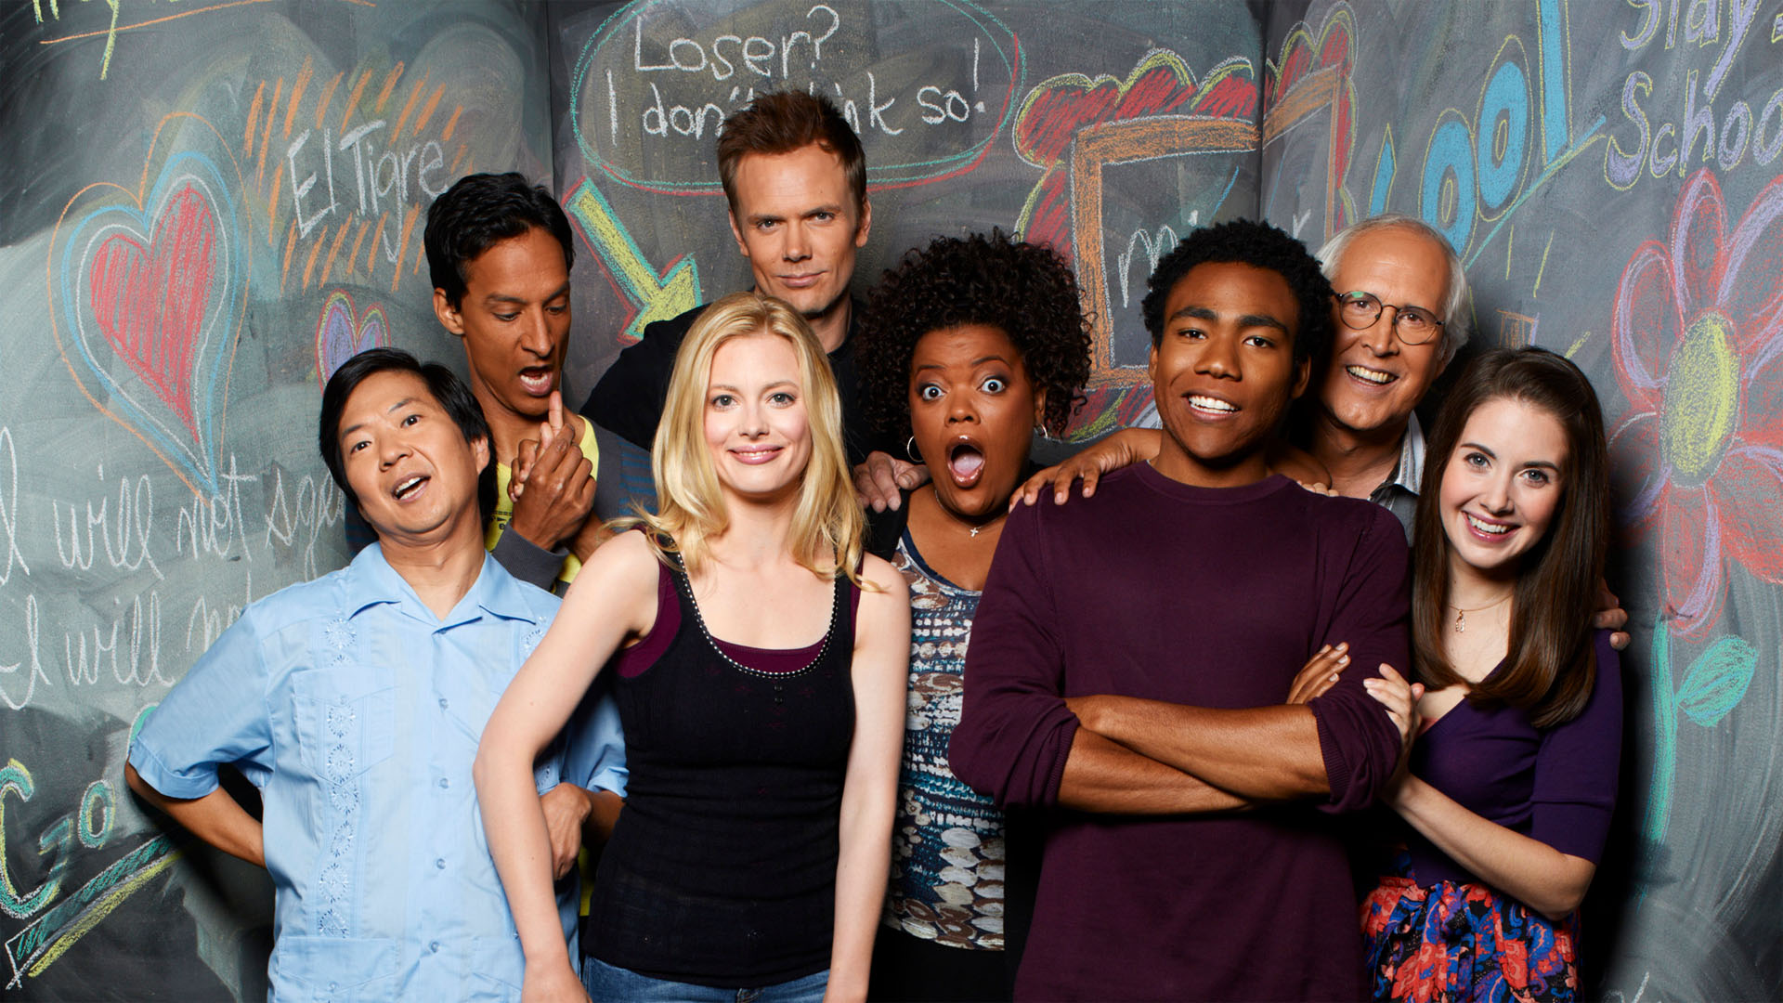

Slide 9
Share a way in which your organization is building strong relationships with your community?
What else could your organization be doing to build strong relationships with your community?

